Slide 1

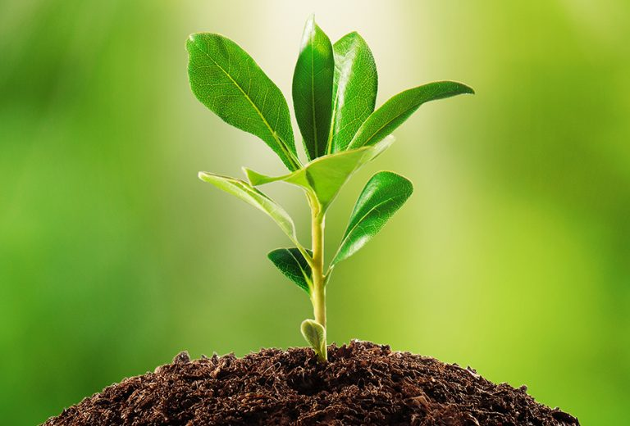

PLANT IDENTIFICATION USING TENSORFLOW

Slide 2
TEAM MEMBERS
JAYAKUMAR S – 9920004053
VISAL J – 992000140
MUTHU MANOJ M – 9920004091
KANAGALINGAM SM - 9920004062

Slide 3
TABLE OF CONTENTS
Motivation
Problem Statement
Objective
Literature survey
Proposed Methodology
Key Contribution
Tools used
Datasets
Experimentation and Results
Conclusion
References

Slide 4
MOTIVATION
A chemist when he was plucking a flower in a garden, he was touched a plant ,and he was felt on the ground.
Finally he was admitted in hospital and he was known that, he had touched Nerium Oleander and he was died.
The main motivation of the project is to help the farmers, chemist to identify what the plants they are touching and seeing in their real life.

Slide 5
PROBLEM STATEMENT
Plant Identification using TensorFlow (Image Classifier)
Image classification is a fantastic application of deep learning where the objective is to classify all the pixels of an image into one of the defined classes.
Plant image identification using deep learning is one of the most promising solutions towards bridging the gap between computer vision and botanical taxonomy.
If we want to take your first step into the amazing world of computer vision, then this is definitely an interesting data science project idea to get started.

Slide 6
OBJECTIVE
To classify the plant 🌱,from the flower of the plant.
Through the size, color, width, petal length and sepal length of the flower, plant is classified.
From the picture, the pixel of the image is particularly classified and its species is identified.

Slide 7
LITERATURE SURVEY
A Convolutional Neural Network (CNN) is a type of artificial neural network used in image recognition and processing that is specifically designed to process pixel data.
A pre-trained convolutional neural network (CNN) was fine-tuned to ex- tract features from super-pixel segmented apple flower images, and then a support vector machine (SVM) classifier was used to judge whether there were apple flowers in the image.
In deep learning, a convolutional neural network (CNN/ConvNet) is a class of deep neural networks, most commonly applied to analyze visual imagery. Now when we think of a neural network we think about matrix multiplications but that is not the case with ConvNet. It uses a special technique called Convolution.

Slide 8

ADVANTAGES of CNN:
CNN learns the filters automatically without mentioning it explicitly. These filters help in extracting the right and relevant features from the input data
CNN captures the spatial features from an image. Spatial features refer to the arrangement of pixels and the relationship between them in an image. They help us in identifying the object accurately, the location of an object, as well as its relation with other objects in an image

Slide 9
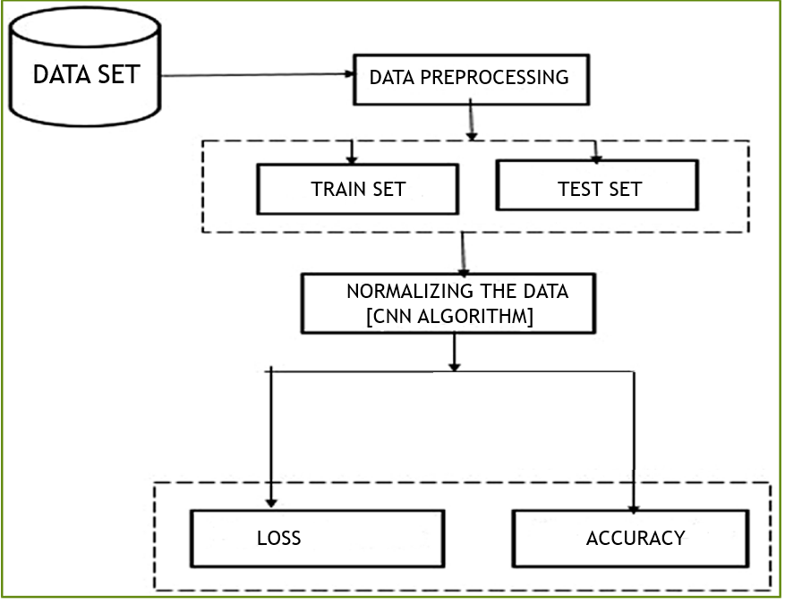
METHODOLOGY:

Slide 10



TOOLS USED
TENSORFLOW
It is an open source artificial intelligence library, using data flow graphs to build models. It allows developers to create large-scale neural networks with many layers. TensorFlow is mainly used for: Classification, Perception, Understanding, Discovering, Prediction and Creation.
Python
Python is commonly used for developing websites and software, task automation, data analysis, and data visualization. Since it's relatively easy to learn, Python has been adopted by many non-programmers such as accountants and scientists, for a variety of everyday tasks, like organizing finances.
Colaboratory
Google Colaboratory is a free online cloud-based Jupyter notebook environment that allows us to train our machine learning and deep learning models on CPUs, GPUs, and TPUs. Here’s what I truly love about Colab. It does not matter which computer you have, what it’s configuration is, and how ancient it might be.

Slide 11
TOOLS
Pandas = Data analysis.
Numpy = Complex mathematical operations
Matplotlib = Data visualization and Graphical plotting
Seaborn = Data visualization and statistical graphics.
Wordcloud = a data visualization technique used for

Slide 12
DATASET USED
The dataset contains raw jpeg images of five types of flowers. It have 3000+ sample dataset images.
daisy
dandelion
rose
sunflower
Tulip
Dataset link:
http://download.tensorflow.org/example_images/flower_photos.tgz

Slide 13
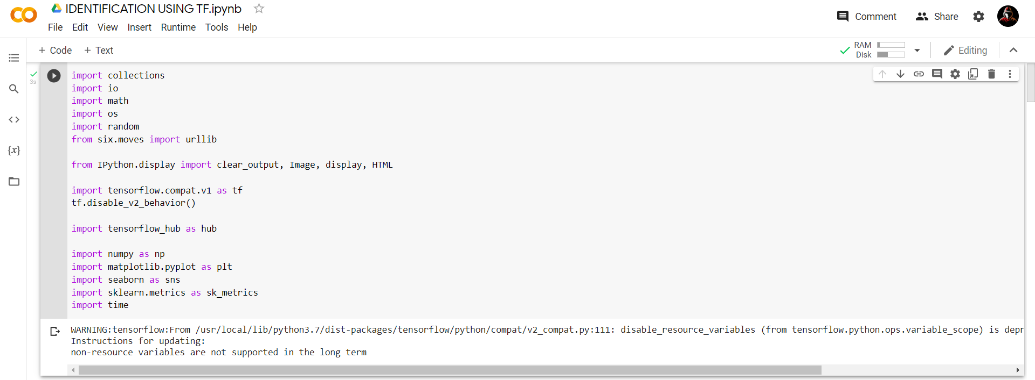
EXPERIMENTATION AND RESULTS
IMPORTING PACKAGES

Slide 14
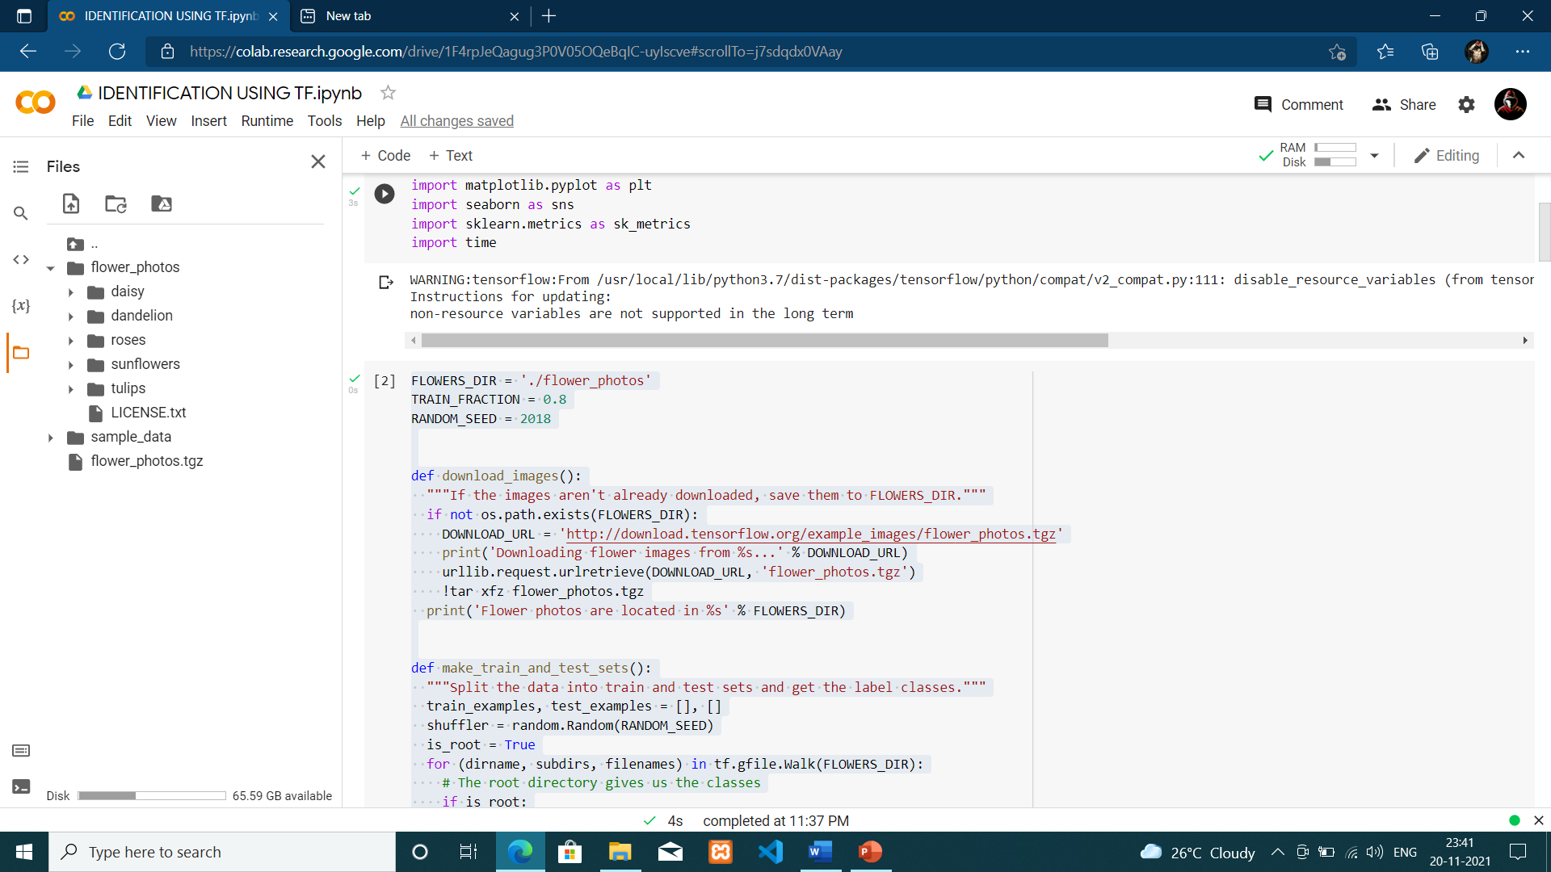
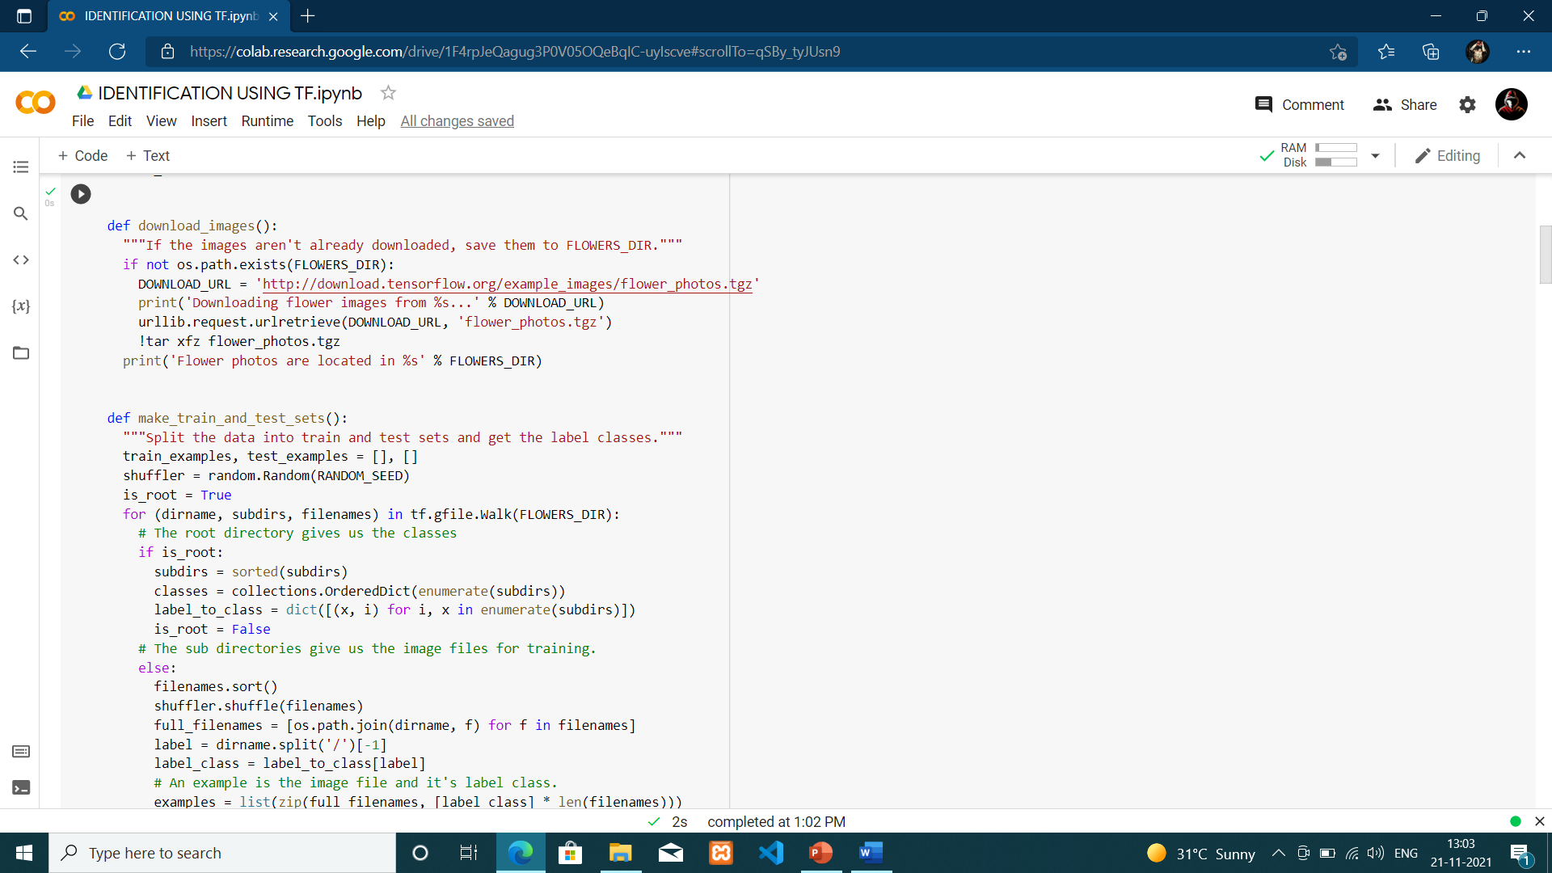
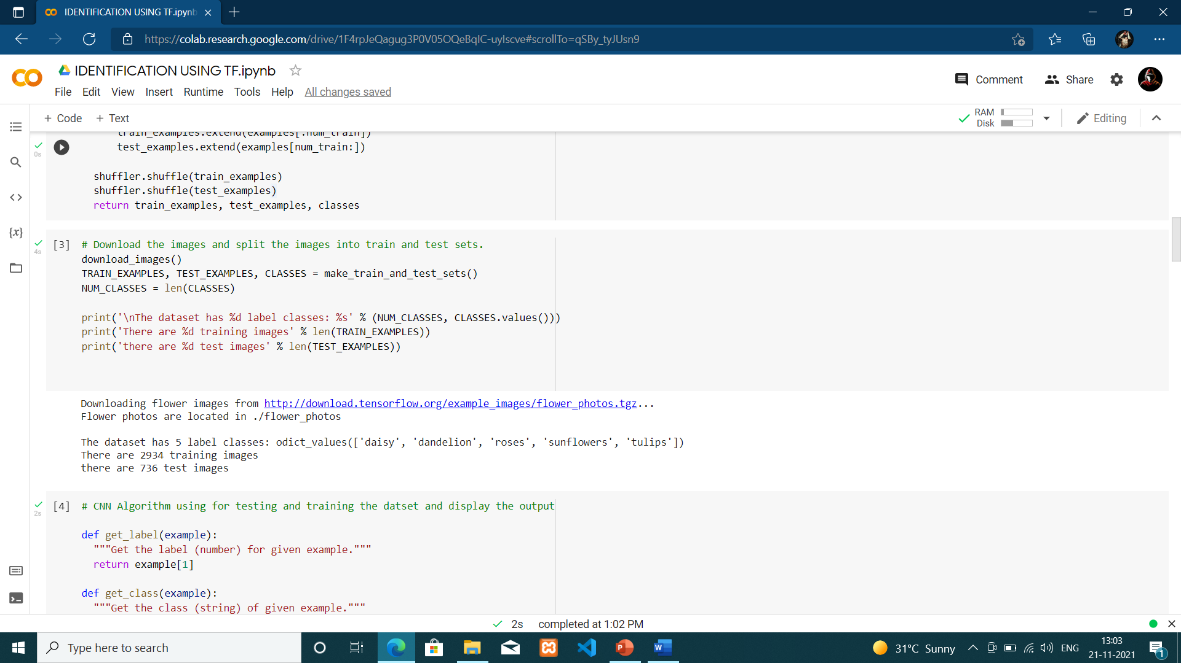
14
IMPORTING AND SPLITTING DATSET AS TEST AND TRAIN

Slide 15
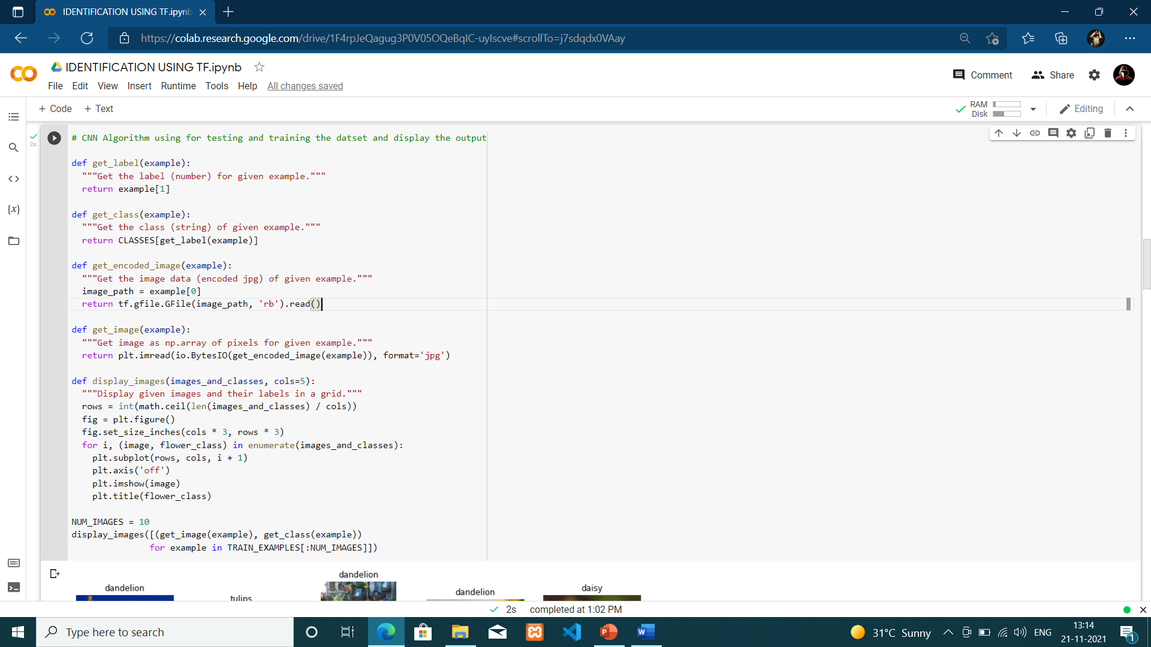
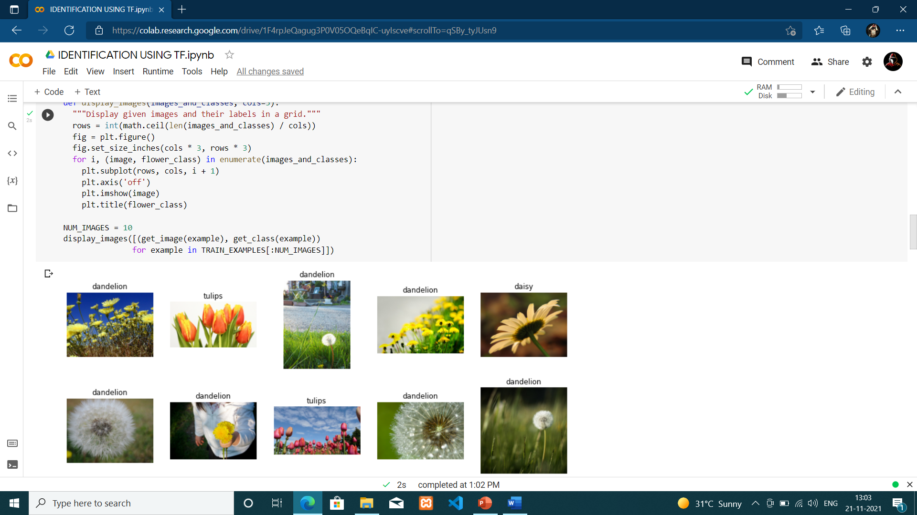
IMPLEMENTATION USING CNN

Slide 16
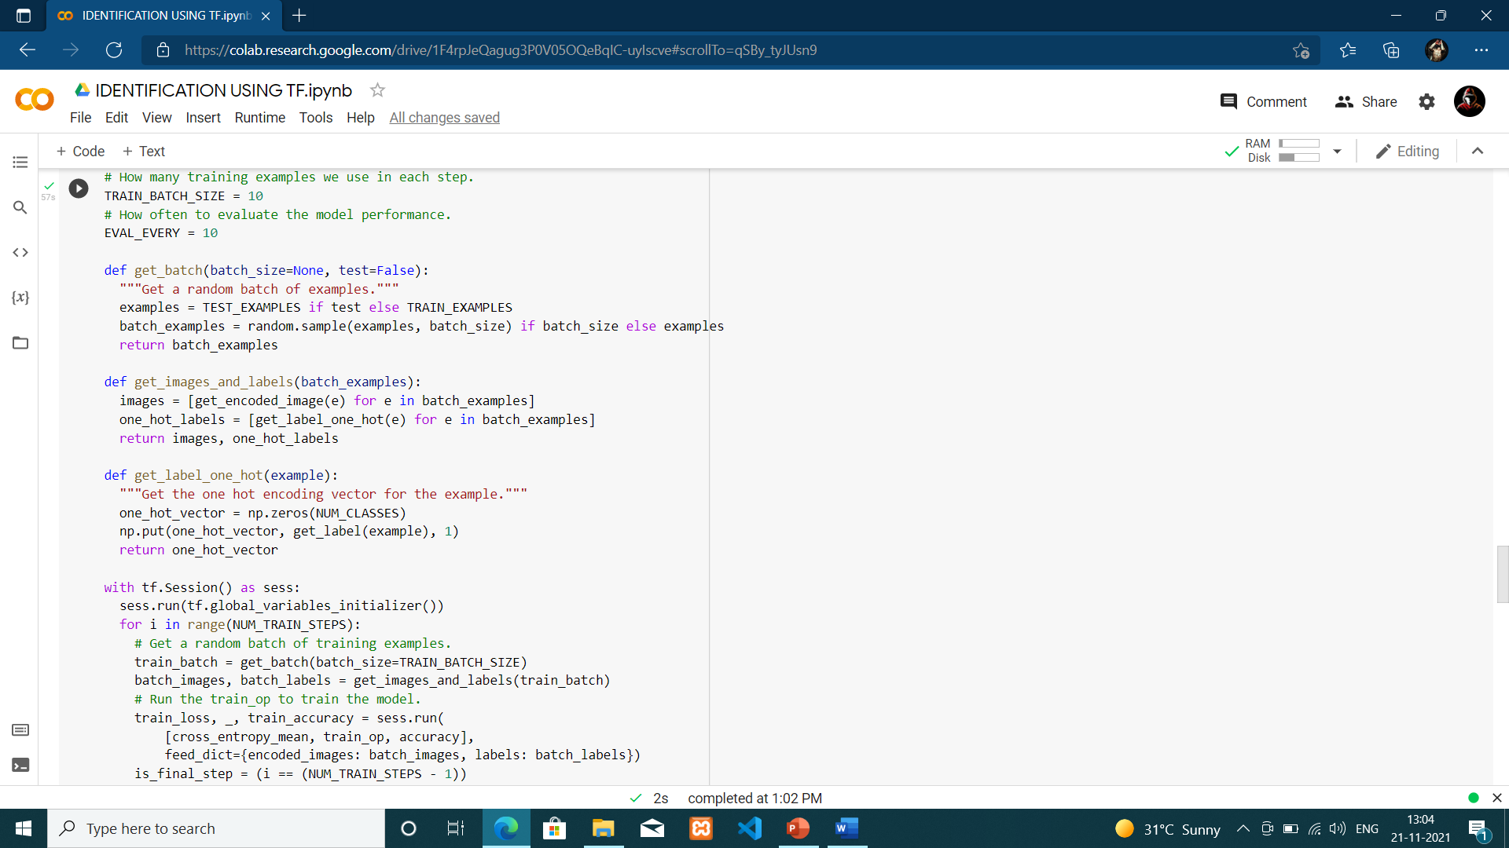
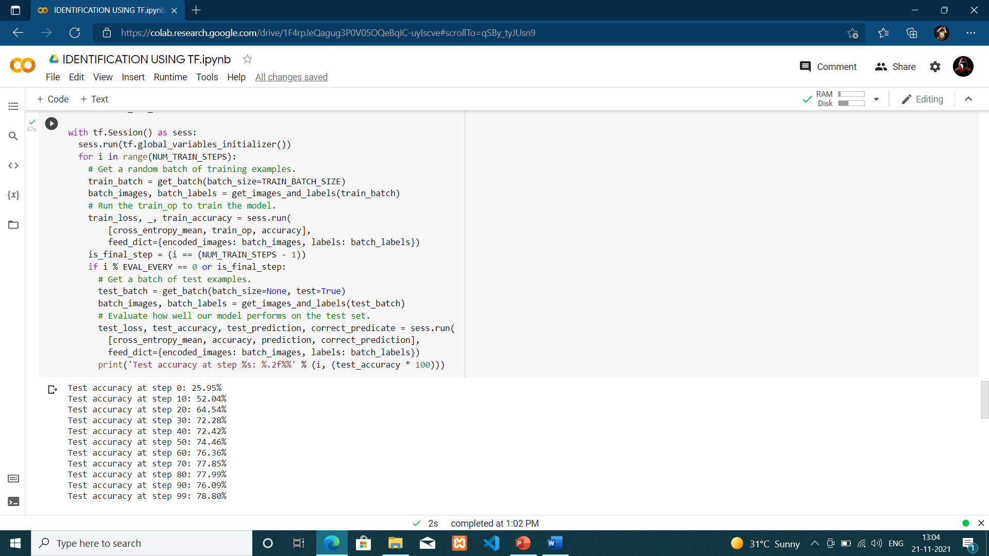
EVALUATING TEST ACCURACY AS STEP BY STEP:

Slide 17
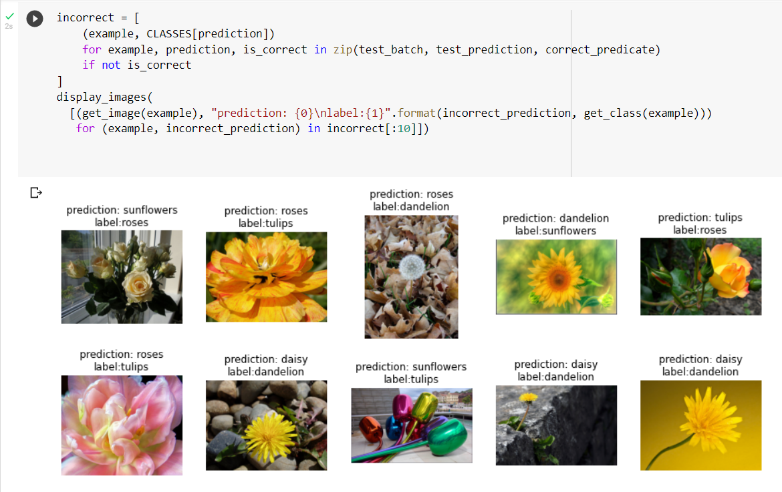
INCORRECT PREDCITION:

Slide 18
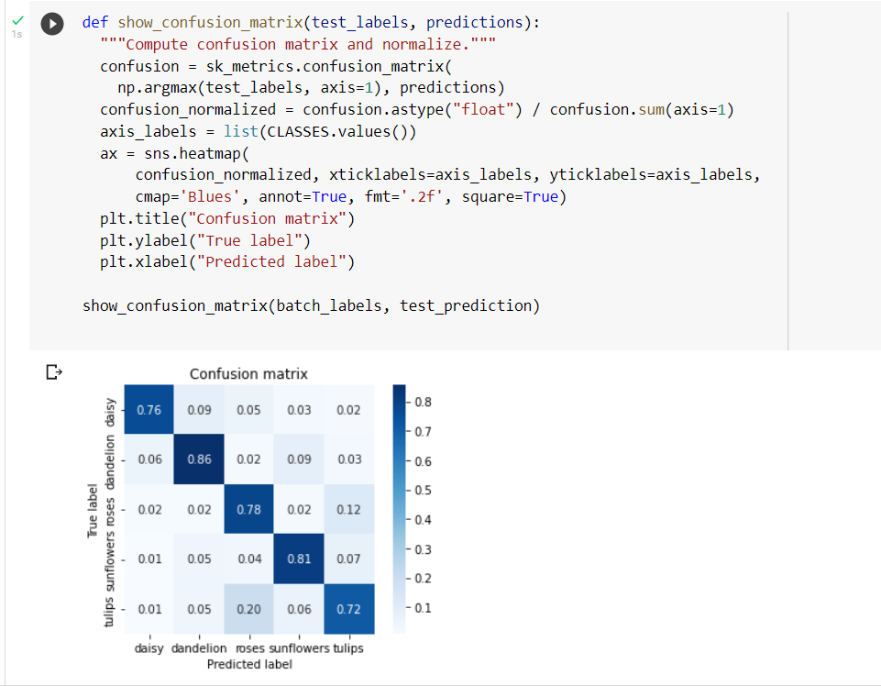
CONFUSION MATRIX

Slide 19
CONCLUSION
Plant Identification is the one of best idea for detect the any kind of plant confirm as using our deep learning technique.
We have learned CNN, one of the most frequently used algorithms in deep learning.
We have learned all about Confusion Matrix and wrong predictions in CNN

Slide 20
REFERENCES
Albadarneh, A., Ahmad, A., 2017. Automated flower species detection and recognition
from digital images. Int. J. Comput. Sci. Network Security 17 (4), 144–151.
Aleya, K.F., 2013. Automated damaged flower detection using image processing. J. Global
Res. Comput. Sci. 4 (2), 21–24.
Badawy, M., Direkoglu, C., 2019. Sea turtle detection using Faster R-CNN for conservation purpose. Springer, Cham, pp. 535–541. https://doi.org/10.1007/978-3-030- 35249-3_68.
Bochkovskiy, A., Wang, C. Y., Liao, H. Y. M., 2020. YOLOv4: Optimal Speed and Accuracy

